Slide 1
Texas Campaign for the Environment
Rosanne Barone
Houston Program Director

Slide 2
Zero Waste Goal
All discarded material is diverted away from landfills and back into the cycle of reuse through policy-based and market-based approaches including recycling, composting and product redesign in order to reduce harm to the environment and public health.
There is no such thing as “away”.

Slide 3
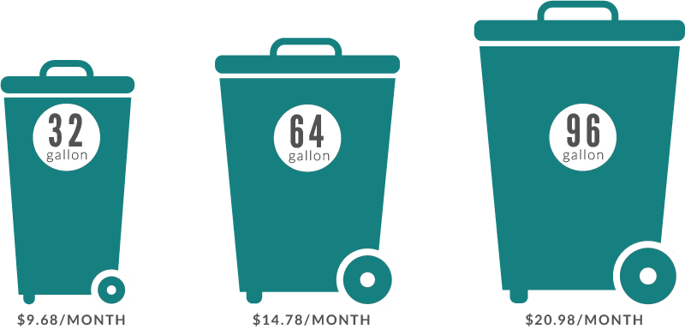
Policies and Programs
Zero Waste Plan
Pay As You Throw
Composting
Universal Recycling Ordinance
Construction & Demolition (C&D)

Slide 4
TX Cities for Zero Waste
Zero Waste Goals in Austin, Dallas, Ft Worth
Curbside recycling in Dallas, Arlington, saved in Lucas, Houston, has spillover benefits after commitment
URO in Austin, composting included in businesses with food
Comprehensive: multi-family and commercial recycling in Austin, Fort Worth, Lewisville, Little Elm, Euless, Frisco, Allen, Cedar Hill
Apartment recycling and curbside composting in Fort Worth, San Antonio
Composting pilot in Ft Worth, apartments in San Antonio, San Marcos
C&D in Austin, Frisco concrete and metal, Plano rebate program

Slide 5
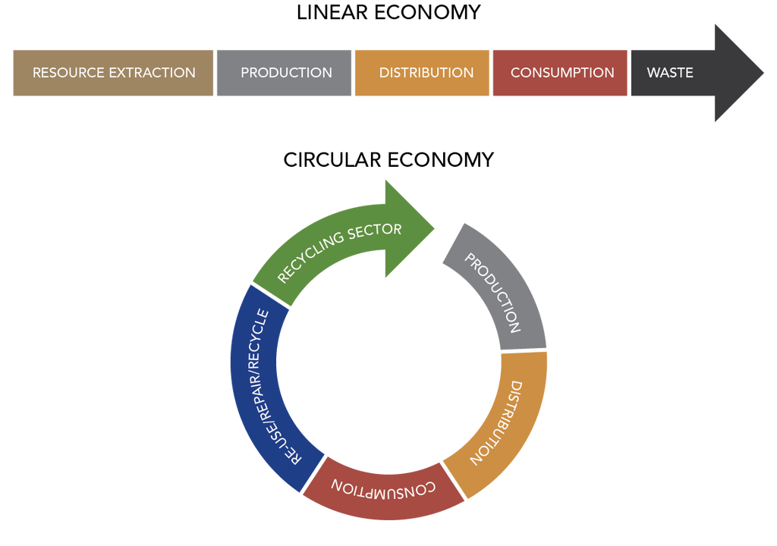
Why do it?
Environmental and public health
Job creation
Sustainability leaders
Personal and governmental responsibility

Slide 6
Zero Waste Houston
One Bin for All, 2014
Single-stream recycling contract, 2018
Post-Harvey planning
Zero Waste Houston on Facebook
www.bagfreebayous.org

Slide 7
More Cities for Zero Waste
Zero Waste Goals in Cedar Park, Georgetown
Recycling for apartments and businesses in Dallas, Denton and Arlington
Long-term solid waste plan with Zero Waste goal in Plano and Richardson
Composting roll-out, and recycling in parks in Austin
Bulk and brush separation in Dallas and Cedar Park

Slide 8
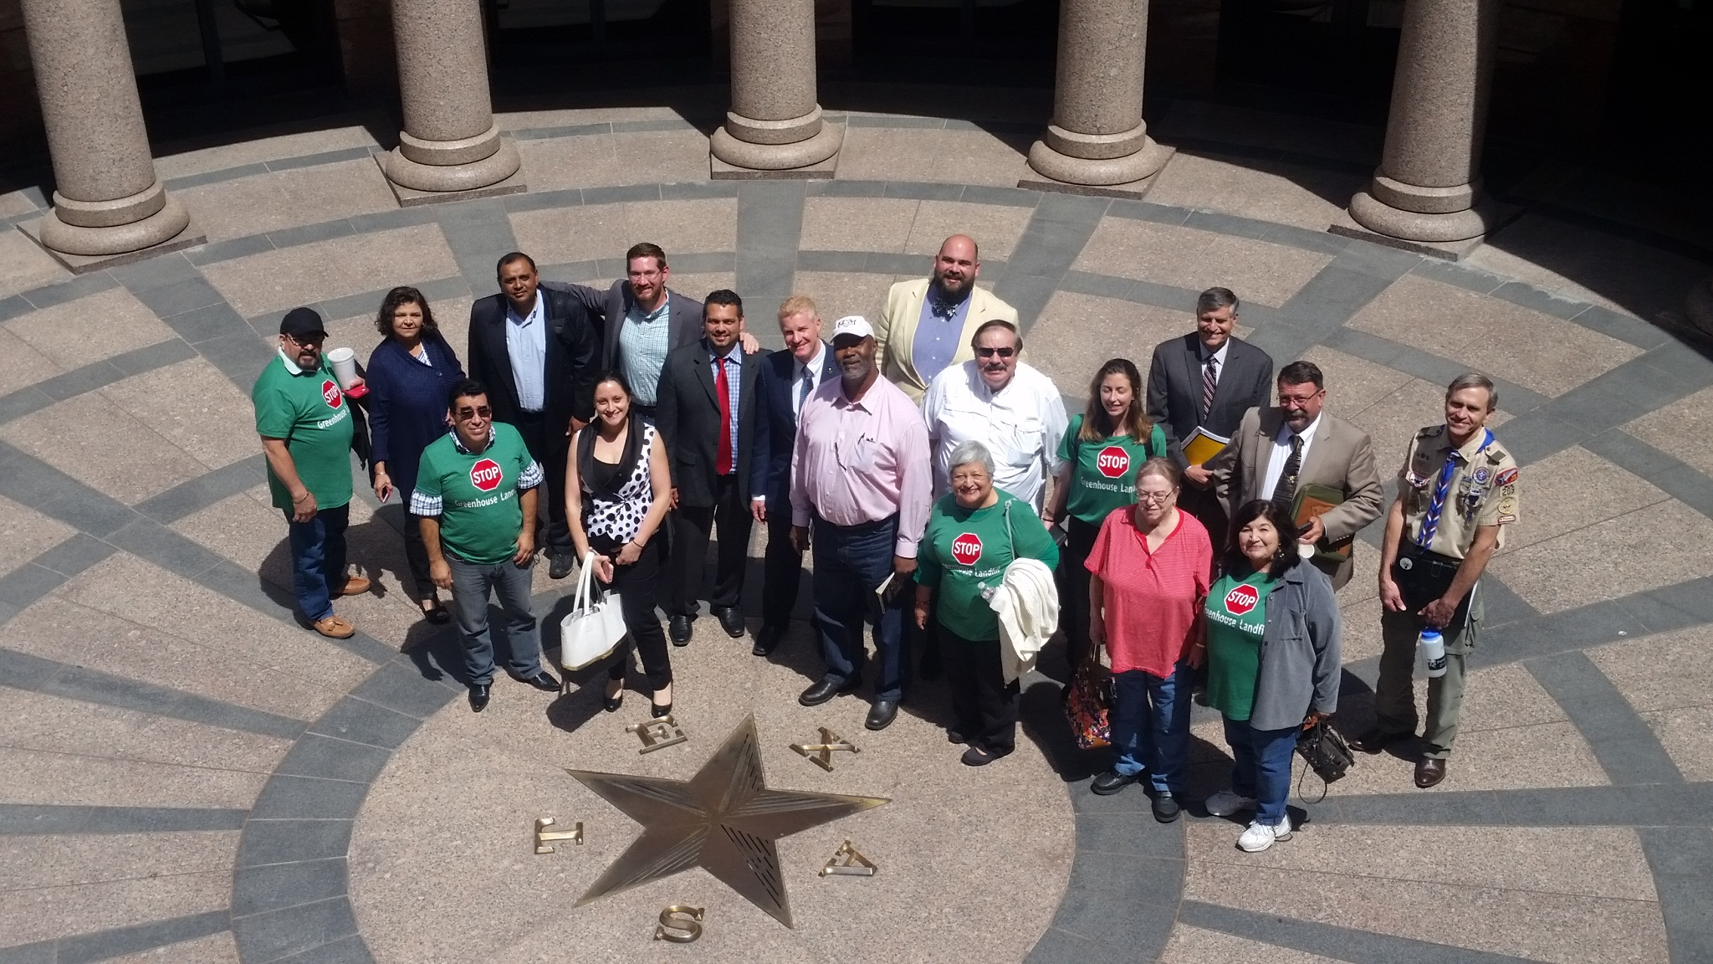
At the State Legislature
Producer take-back programs - computers in 2007, TVs in 2011
Single-use bag
ordinances
Biosolids regulations
Landfill regulations

Slide 9
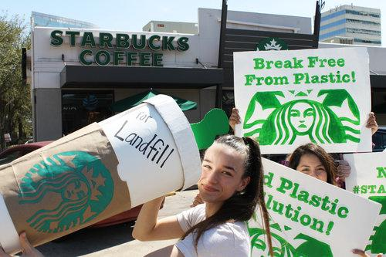
Global Effort
Zero Waste policies internationally
Reduction
Production
www.breakfreefromplastic.org

Slide 10
rosanne@texasenvironment.org
713-337-4192
www.texasenvironment.org
www.facebook.com/ZeroWasteHouston
www.zerowastedfw.org/zero-waste-dallas

