Slide 1


City of Houston
Water System
Nooreen Jilani, P.E.
City of Houston
Public Works & Engineering
Infrastructure Planning
October 04, 2012
Notes:
Lots of ways to think about Houston’s water
Deliver annual average of 400 MGD
of water (Max. 672 MGD)
Service 470,000 customer accounts
1,162,720 connections
2,940,000 residents
Maintain 7,480 miles of water lines
54,000 Fire Hydrants
150,000 Valves

Slide 2
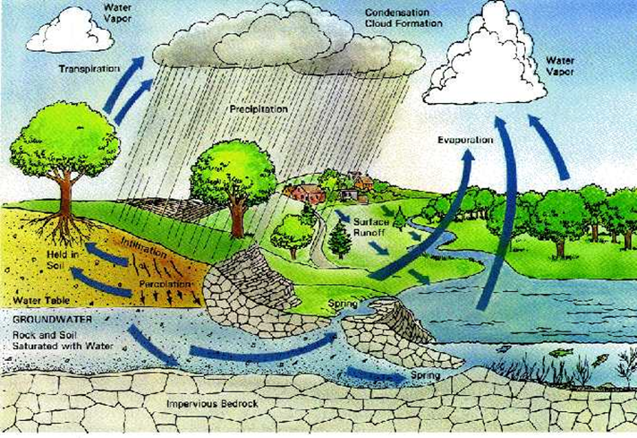

Slide 3
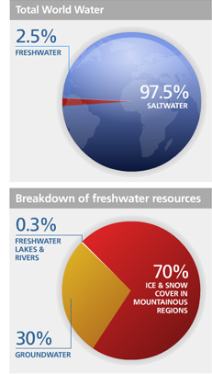
70 % of the earth is comprised of water but out of this only 2.5 % is fresh water
Out of this 2.5 %
only 1 % is
available for humans and
ecosystem

Slide 4
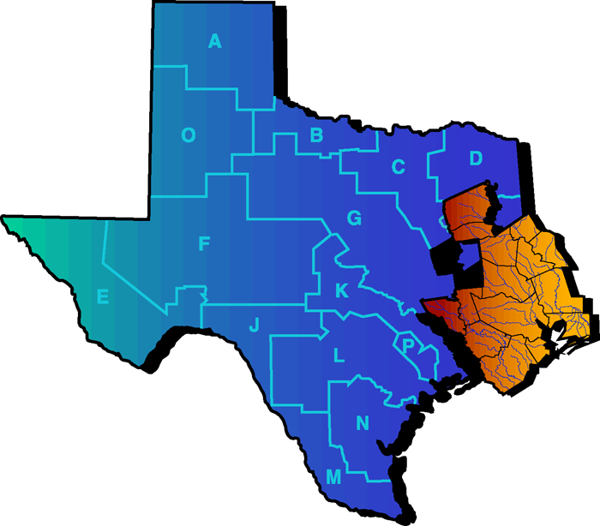
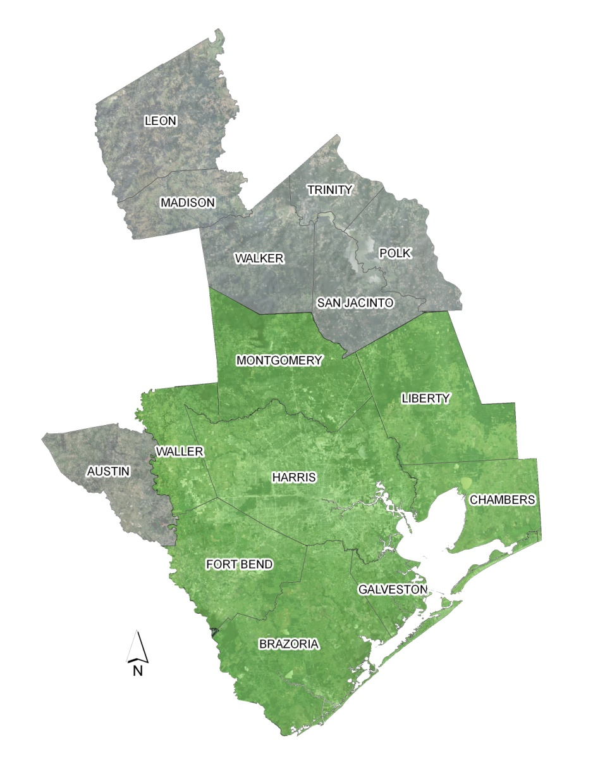
State Water Planning Regions
Houston and suburbs are in Region H

Slide 5

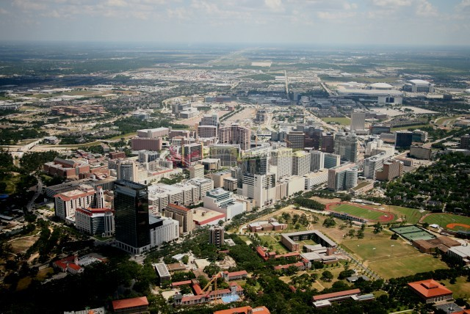
City of Houston
Water System
Texas Medical Center Houston
Lisa Lattu, PE & AICP
City of Houston Public Works & Engineering
Infrastructure Planning
September 16, 2011
Downtown Houston
Notes:
Lots of ways to think about Houston’s water
Deliver annual average of 400 MGD
of water (Max. 672 MGD)
Service 470,000 customer accounts
1,162,720 connections
2,940,000 residents
Maintain 7,480 miles of water lines
54,000 Fire Hydrants
150,000 Valves

Slide 6
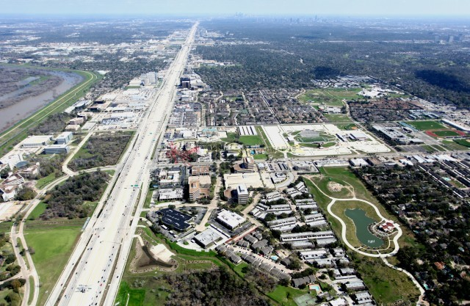
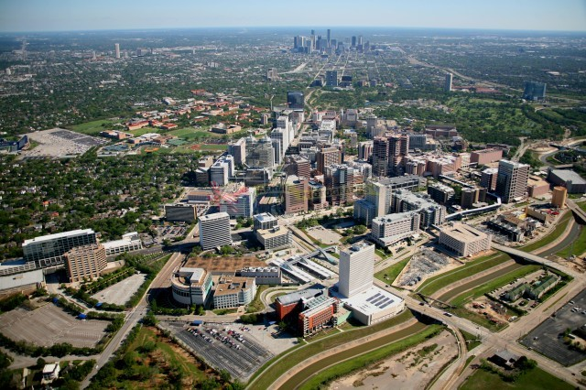
Galleria
Energy Corridor

Slide 7
Challenges we face
Houston is nation’s fourth largest City
Houston has no geographical boundaries to limit expansion
It is a challenge to plan, built, maintain and manage the water system to meet Houston’s
ever increasing needs

Slide 8
Components of Water Planning
Water Sources and Rights
(Supply)
Demands
(Customers)
Conveyance System
(Raw Water)
Treatment and Pressurizing
(Plants and Re-Pump Stations)
Transmission and Distribution
(Treated Water)

Slide 9
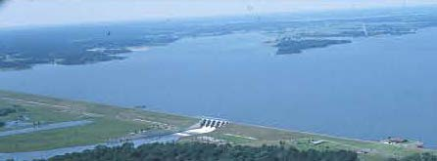
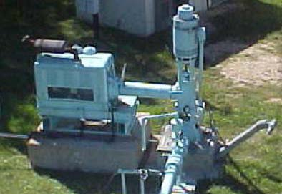
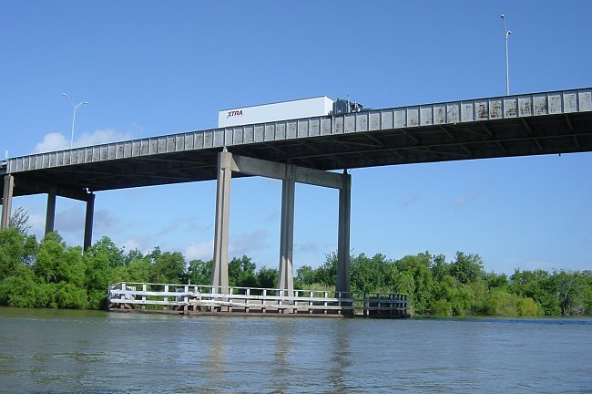
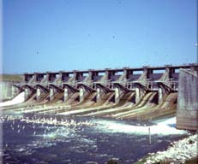

Today’s
Water
Sources
Lake Livingston 1969
Dam on Trinity River
Lake Conroe 1973
Dam on San Jacinto River
Trinity River
Ground Water
Wells
Lake Houston 1954
Dam on San Jacinto River

Slide 10
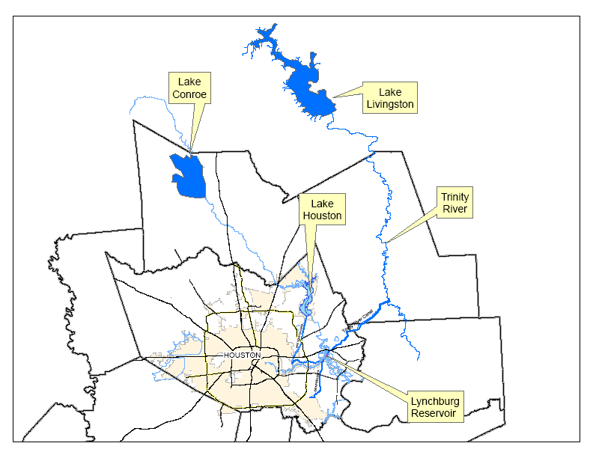
Surface Water Sources

Slide 11
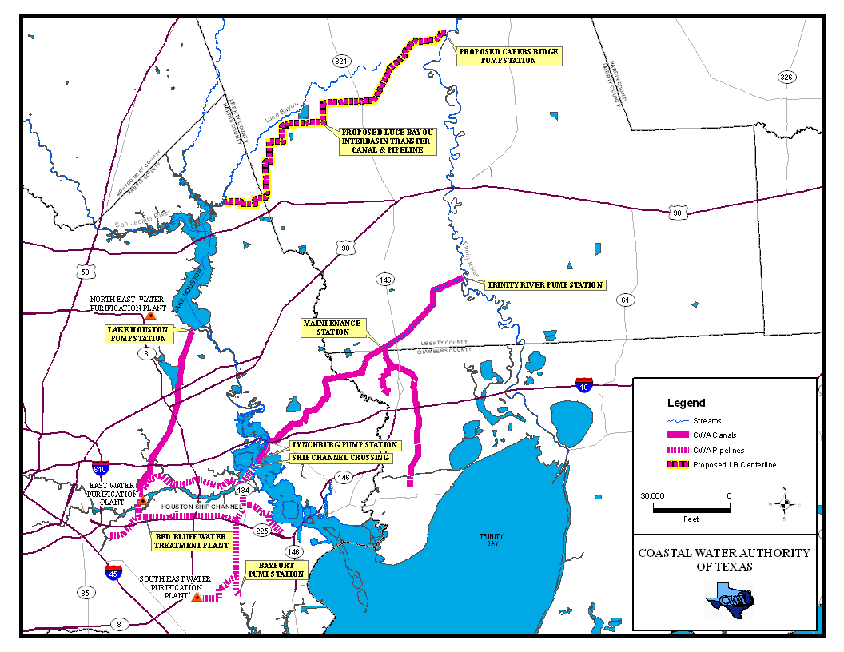


Coastal Water Authority Water Conveyance Canals
Notes:
MAIN CANAL
22 miles clay lined gravity flow with a gradient of .9 ft per mile
Normal water surface width of 100 Ft.
Normal Water Depth is14 Ft.
Capacity: Exceeds 1.3 Billion Gallons/Day
TRINITY RIVER PUMP STATION
Ultimate Pumping Units: 18 Vertical Pumps
Ultimate Capacity (Gallons/Day) 1.4 Billion
Existing Pumping Units: 16 Vertical Pumps
Existing Capacity (Gallons/Day)
1.3 Billion total with all 16 pumps
1.0 Billion with 3 Large pumps on Stand-by.

Slide 12
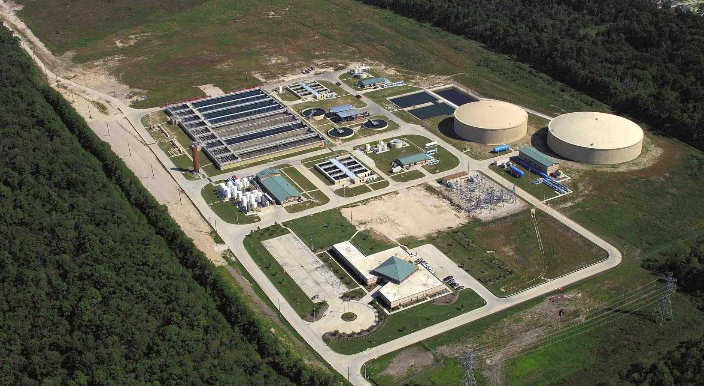
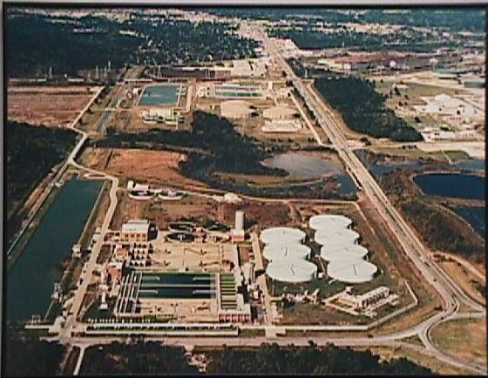
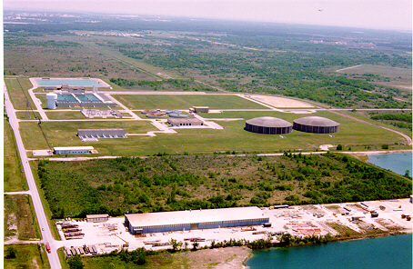
Treatment Plants
Northeast Water Purification Plant 80 MGD (Million gallon per day)
East Water Purification Plant
350 MGD (Million gallon per day)
Southeast Water Purification Plant
200 MGD (Million gallon per day)

Slide 13
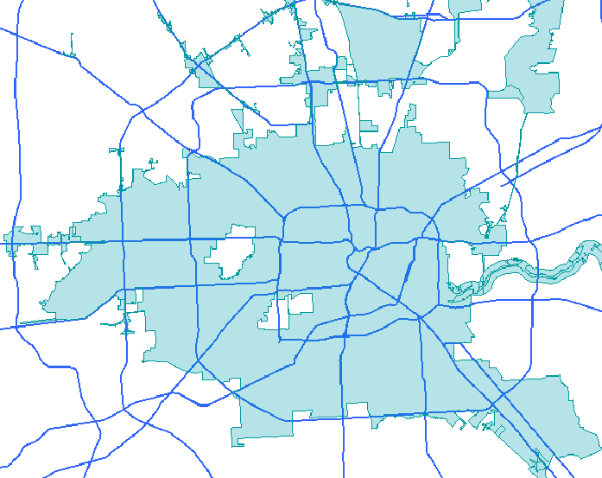
Water Treatment and Transmission System
Major Roads
Re-pressurization Locations
New, Small, North East Surface Water Plant
Original,
Large, East Surface Water Plant
Medium, South East Surface Water Plant

Slide 14
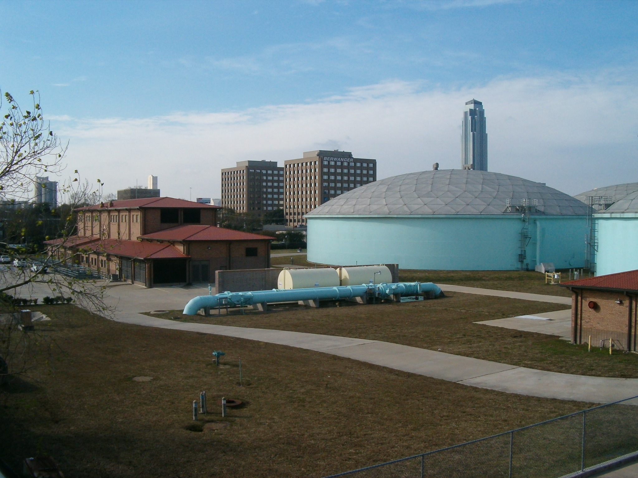
Southwest Re-pump Station

Slide 15
Water Supply and Demand
San Jacinto River Basin
Lake Conroe 60 MGD (Million gallon per day)
Lake Houston 163 MGD
with an additional 36 MGD Run of River
Bayou & Reuse permits 634 MGD With environmental flows dedication
Trinity River Basin
Lake Livingston 806 MGD
Wallisville 34 MGD
Barbers Hill Canal 40 MGD
Dayton Canal 34 MGD
Brazos River
Allens Creek 62 MGD In Planning
Total Permitted Water Rights 1,869 MGD
Available Groundwater 235 MGD (Per Local Regulations)
City of Houston Annual Average Demand is 400 mgd and Peak Demand is 672 mgd
Total Annual Average Demand = 400 mgd+ 350 mgd (Suburbs)+ 240 mgd (Industry)

Slide 16
Water Customers
Municipal
Utility
Districts
(MUD’s)
Strategic
Partners
(Water Authorities)
Large
Industrial
Houston
Citizens
Water
Resources
Commercial
Industrial
Local
Cities &
Villages
SE Plant
Participants
Local
Cities
Treated Water Customers
Untreated Water Customers

Slide 17
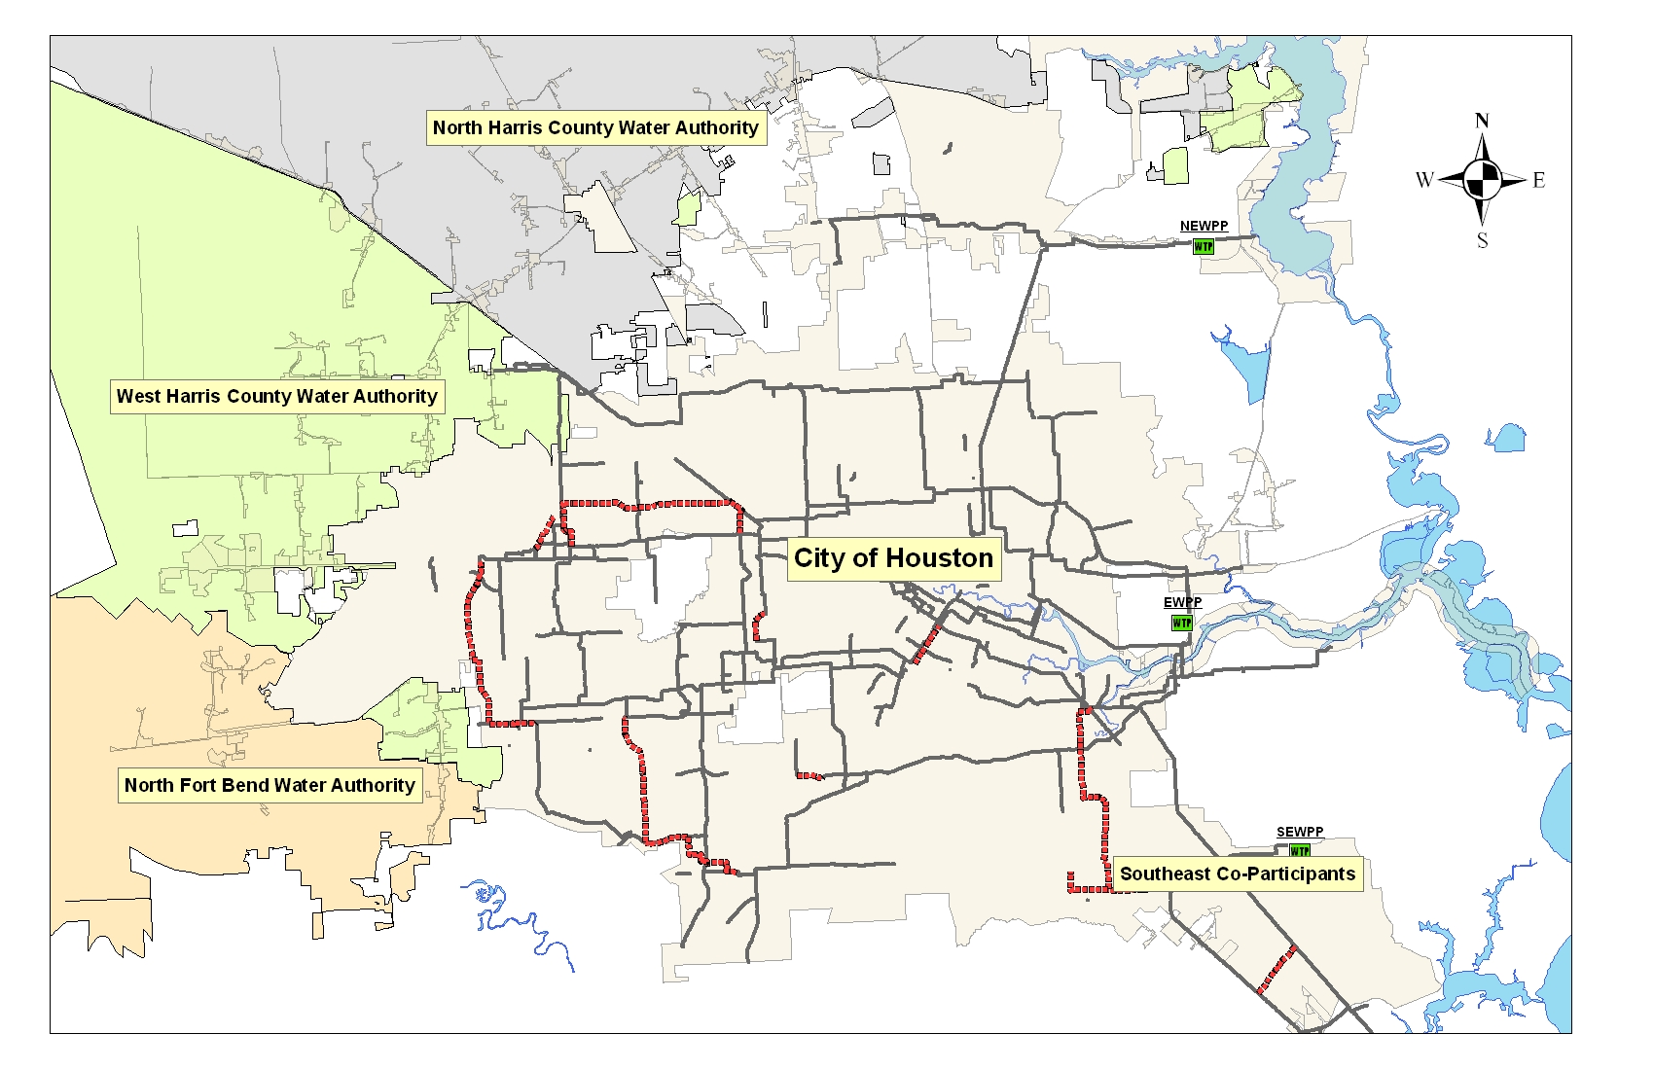
Strategic Partner-Customers

Slide 19
Subsidence:
Is the motion of the Earth's surface as it shifts downward relative to a datum such as sea-level
1940 benchmark re-leveling results show that Baytown area has subsided 3.2 feet and Texas City Area has subsided 1.6 feet
Detailed research by Houston Chamber of commerce
in 1947 showed that excessive pumping of ground
water is the major cause of subsidence
Harris Galveston Subsidence district was established in
1975 to regulate and limit pumping in Harris and
Galveston counties by issuing ground water permits

Slide 20
Area 3
Surface water
Conversion Requirements
Area I 90%
Area II 80%
Area III
  30% by 2010
  70% by 2020
  80% by 2030
Area 2
Area 1
2011 Surface Water Conversion
Area I: 100%
Area II: 93.1%
Area III: 49.51%
Harris-Galveston Subsidence District
Surface Water Conversion Plan

Slide 21
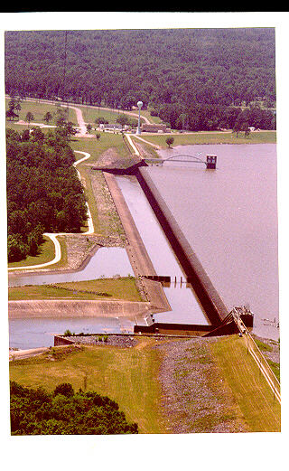
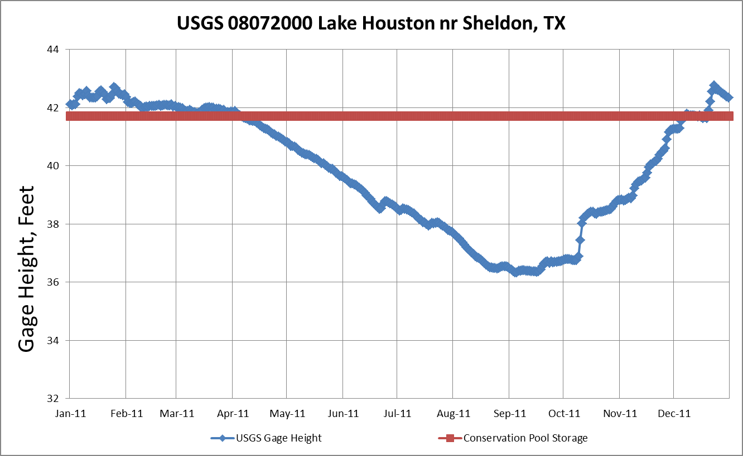
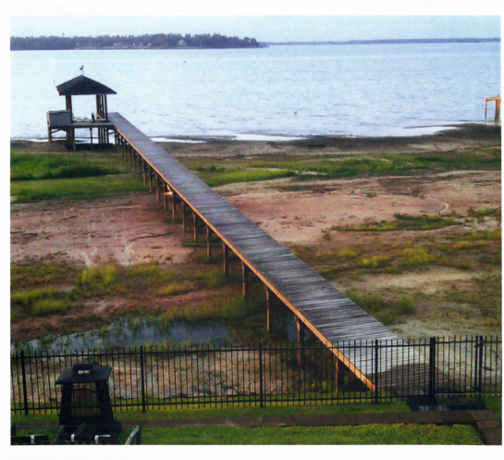
Lake Houston Reservoir Level 2011

Slide 23
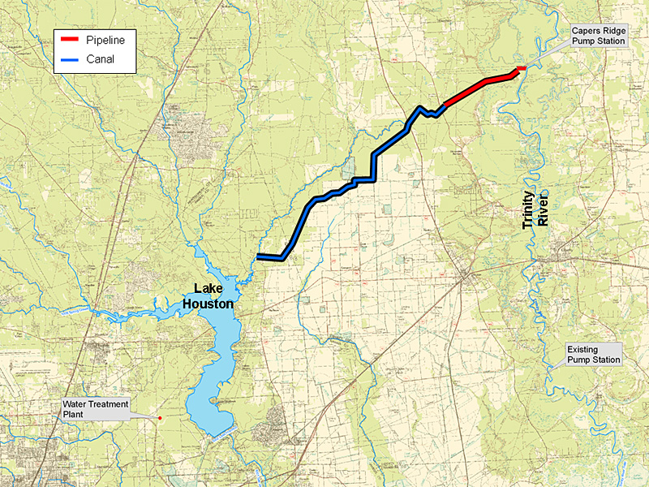
Luce Bayou Project

Slide 24
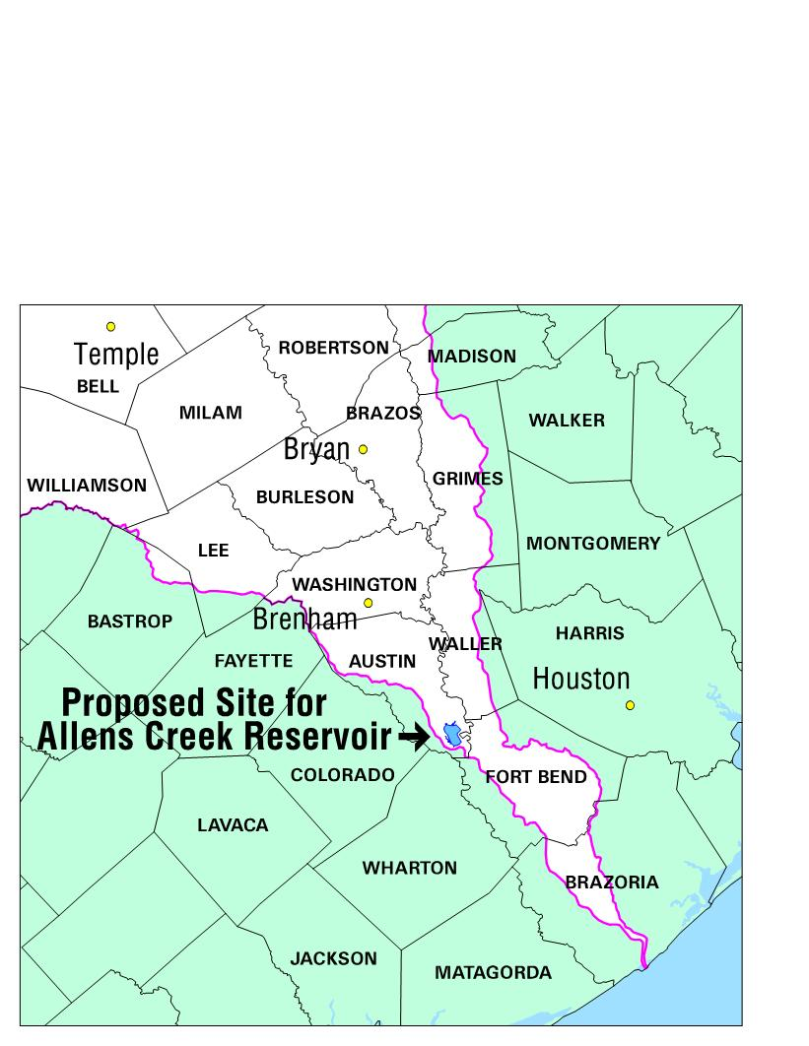
Future Water Supply Projects
Allens Creek Reservoir

Slide 25
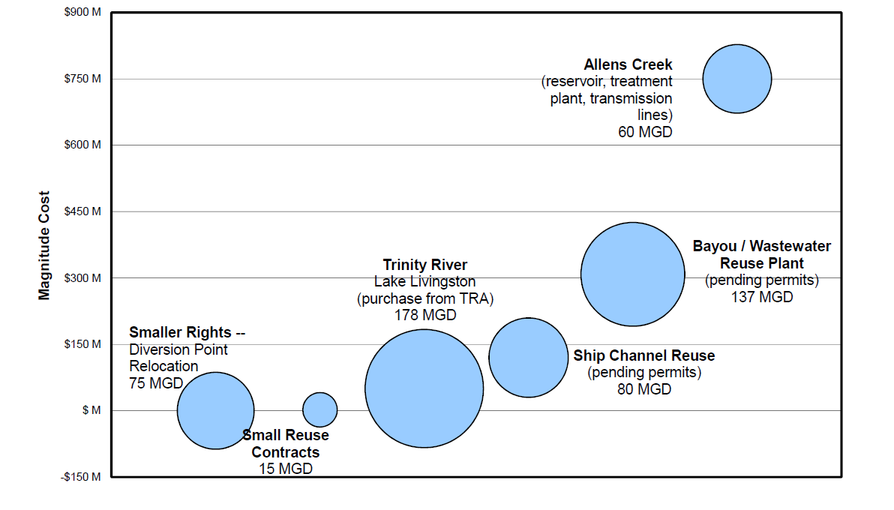

Slide 26
City of Houston works diligently to meet the ever-growing water needs
Planning with its continuous efforts make sure that City has enough resources and capacity in the system to meet the existing and future demands
Engineering and Construction manage the building of
new water infrastructure
Operations and maintenance groups work hard to ensure that all the facilities are running adequately for uninterrupted supply to the citizens
Water quality groups do sampling, testing and cross connection control to maintain and improve the water quality through their continuous surveillance.

Slide 28

Rain/Storm
Water
Groundwater
Wastewater
ONE
WATER
Drinking
Water
Recycled
Water
Notes:
28
Doug Walters, P.E.
LA Sanitation

Slide 29
Thank you
Questions?

