Slide 1
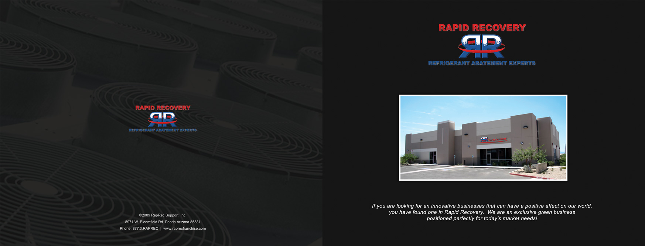
The Nations Largest Refrigerant Recovery Company
45 Locations Nationwide

Slide 3
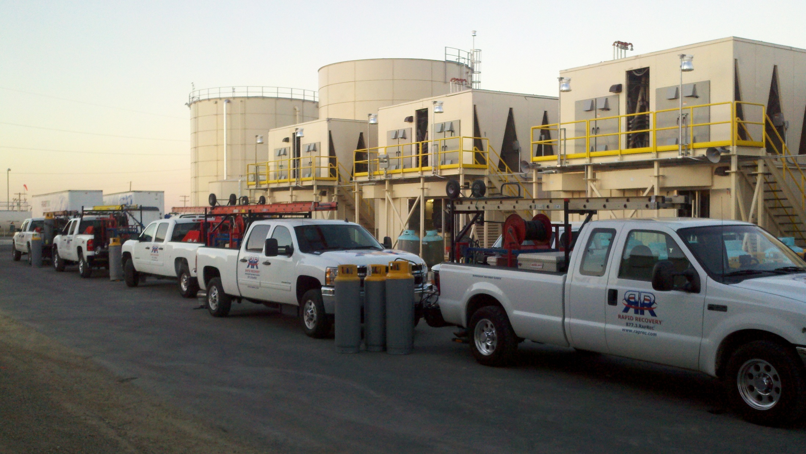

Slide 4
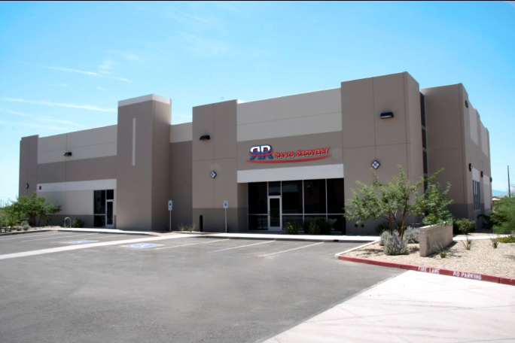
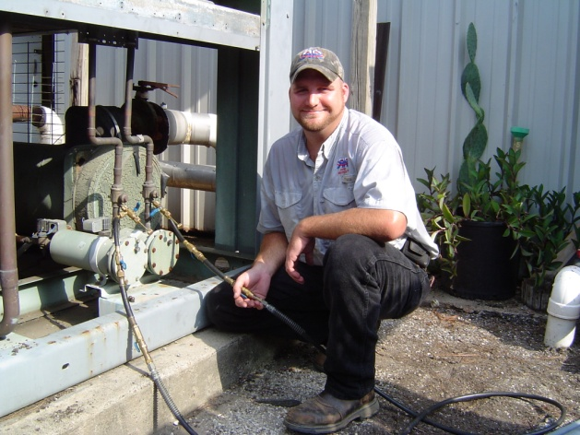
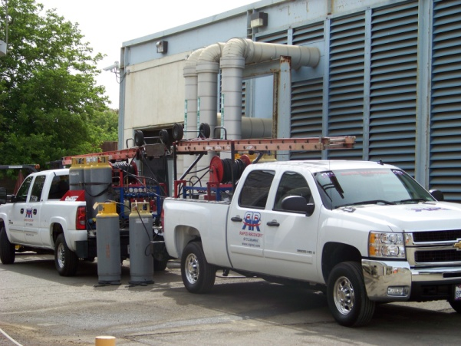
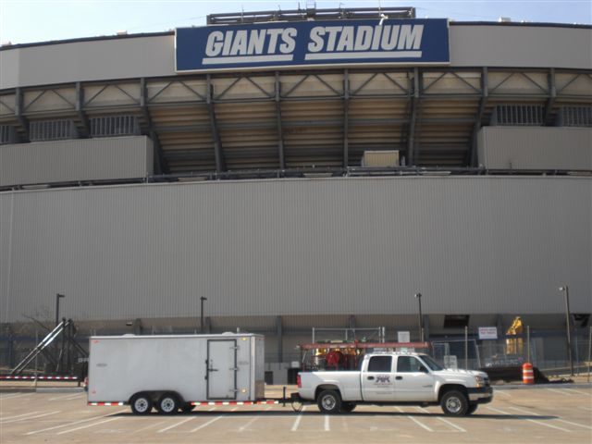
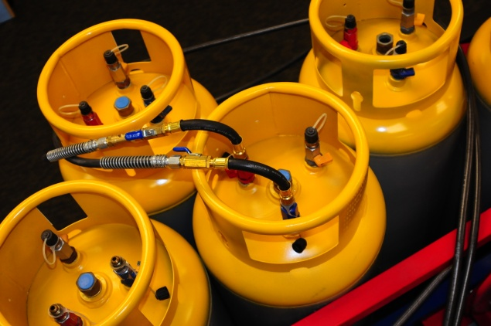
The ONLY nationwide refrigerant abatement company
www.raprec.com
877.3.RAPREC

Slide 5
U.S. Environmental Protection Agency
U.S. Environmental Protection Agency
EPA Environmental Protection Agency
Text goes in here and looks better when it’s really long…
Content goes in here… or insert pictures, or whatever you want to do.
I.
II.
III.
IV.
V.
U.S. Environmental Protection Agency
www.raprec.com
877.3.RAPREC

Slide 6
EPA Environmental Protection Agency
EPA established April 1970 – Richard Nixon
Establish and enforce environmental protection standards
Conduct research on the adverse effects of pollution
Assist others in arresting pollution
Assist in developing and recommending new policies
www.raprec.com
877.3.RAPREC

Slide 7
EPA Clean Air Act
Clean Air Act Amendments 1990
Clean Air Act 1970
Clean Air Act Amendments of 1977
Montreal Protocol 1987
(International agreement by 191 countries)
Introduction of Section 608
www.raprec.com
877.3.RAPREC

Slide 8
EPA Clean Air Act Section 608
Clean Air Act Section 608 (http://www.epa.gov/ozone/title6/608/)
“minimize the emission of refrigerants by maximizing the recovery and recycling of such substances”
Sales and Distribution
Leak repair requirement
Venting prohibited
Record keeping requirements
Technician and equipment certification
Recycle, recover, reclaim
www.raprec.com
877.3.RAPREC

Slide 9
CAA The three “Rs”
Recycle:
To extract refrigerant from an appliance and clean refrigerant for reuse without meeting all of the requirements for reclamation. Recycled refrigerant may not be resold and can only be used by same owner.
www.raprec.com
877.3.RAPREC

Slide 10
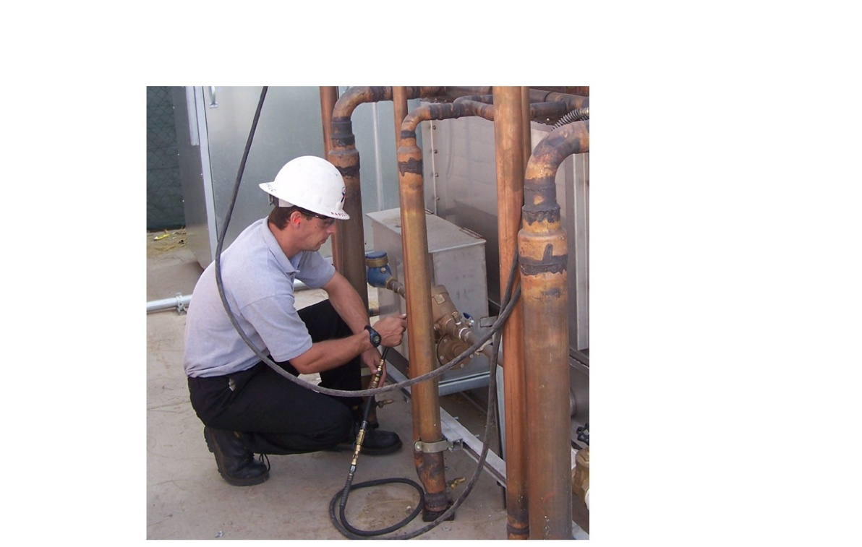
CAA The three “Rs”
Recovery
www.raprec.com
877.3.RAPREC

Slide 11
CAA The three “Rs”
Recover:
To remove refrigerant in any condition from an appliance and store it in an external container without necessarily testing or processing it in any way.
www.raprec.com
877.3.RAPREC

Slide 12
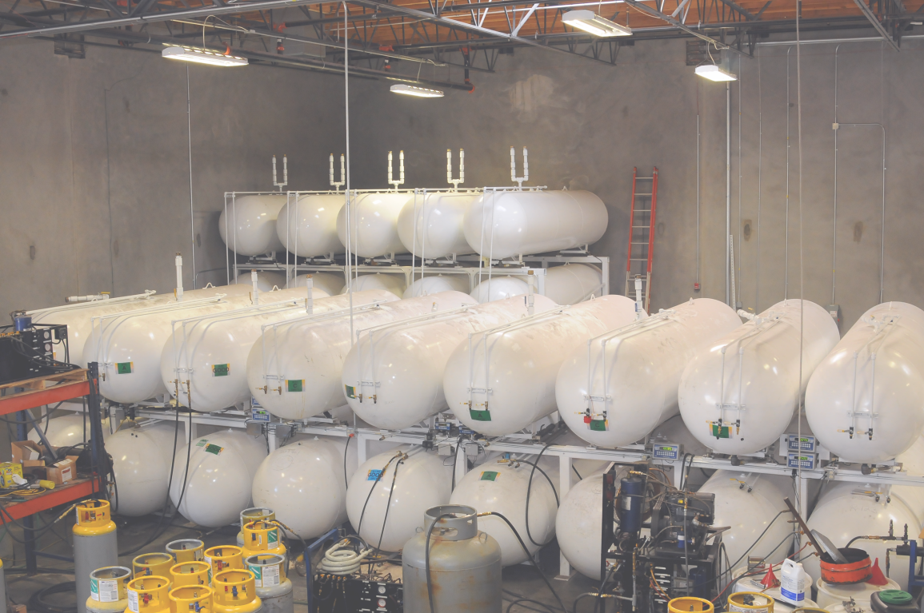
CAA The three “Rs”
Reclaim
www.raprec.com
877.3.RAPREC

Slide 13
CAA The three “Rs”
Reclaim:
The re-processing and upgrading of a recovered controlled substance through such mechanisms as filtering, drying, distillation and chemical treatment in order to restore the substance to a specified standard of performance. Must be done by a certified reclaimer.
www.raprec.com
877.3.RAPREC

Slide 14
CAA The three “Rs”
Reclaim:
To reprocess refrigerant to at least the purity specified in the ARI Standard 700-1993, Specifications, and to verify this purity. Reclamation requires specialized machinery not available at a particular job site. The technician will recover the refrigerant and then send it either to a reclaimer or back to the refrigerant manufacturer.
www.raprec.com
877.3.RAPREC

Slide 15
CAA The three “Rs”
Recovery
Every system must be:
Recovered – venting is prohibited
Recovered by a certified technician
Recovered using certified equipment
Recorded and documented
www.raprec.com
877.3.RAPREC

Slide 16
U.S. Environmental Protection Agency
U.S. Environmental Protection Agency
EPA Enforcement
Text goes in here and looks better when it’s really long…
EPA Enforcement Penalties
Title 42, Chapter 85, Subchapter 1. Part A § 7413
The Administrator may issue an administrative order against any person assessing a civil administrative penalty of up to $25,000, per day of violation…
Inflation adjusted to $37,500 in 2009
Up to $10,000 award for reporting violations that result in a penalty
Content goes in here… or insert pictures, or whatever you want to do.
I.
II.
III.
IV.
V.
U.S. Environmental Protection Agency
www.raprec.com
877.3.RAPREC

Slide 17
U.S. Environmental Protection Agency
U.S. Environmental Protection Agency
EPA Enforcement
Text goes in here and looks better when it’s really long…
EPA Enforcement Actions
August, 2012: Icicle Seafoods $430,000 venting, illegally importing, non-certification (techs & equip), inadequate paperwork
Oct 18, 2011: BIV $300,000 penalty plus $600,000 upgrades (leaks)
Feb 24, 2011: Metal Management West $75,000 (no paper trail)
Jul 15, 2010: City of Tacoma $525,000 for venting
Oct 21, 2009: 5 Cleveland companies cited for venting
Oct 6, 2009: Metal Recycling Systems fined $30,000
Content goes in here… or insert pictures, or whatever you want to do.
I.
II.
III.
IV.
V.
U.S. Environmental Protection Agency
www.raprec.com
877.3.RAPREC

Slide 18
The Nations Largest Refrigerant Recovery Company
45 Service Locations Nationwide

