Slide 1
Updates to the Section 608 Refrigerant Management Program

Slide 2
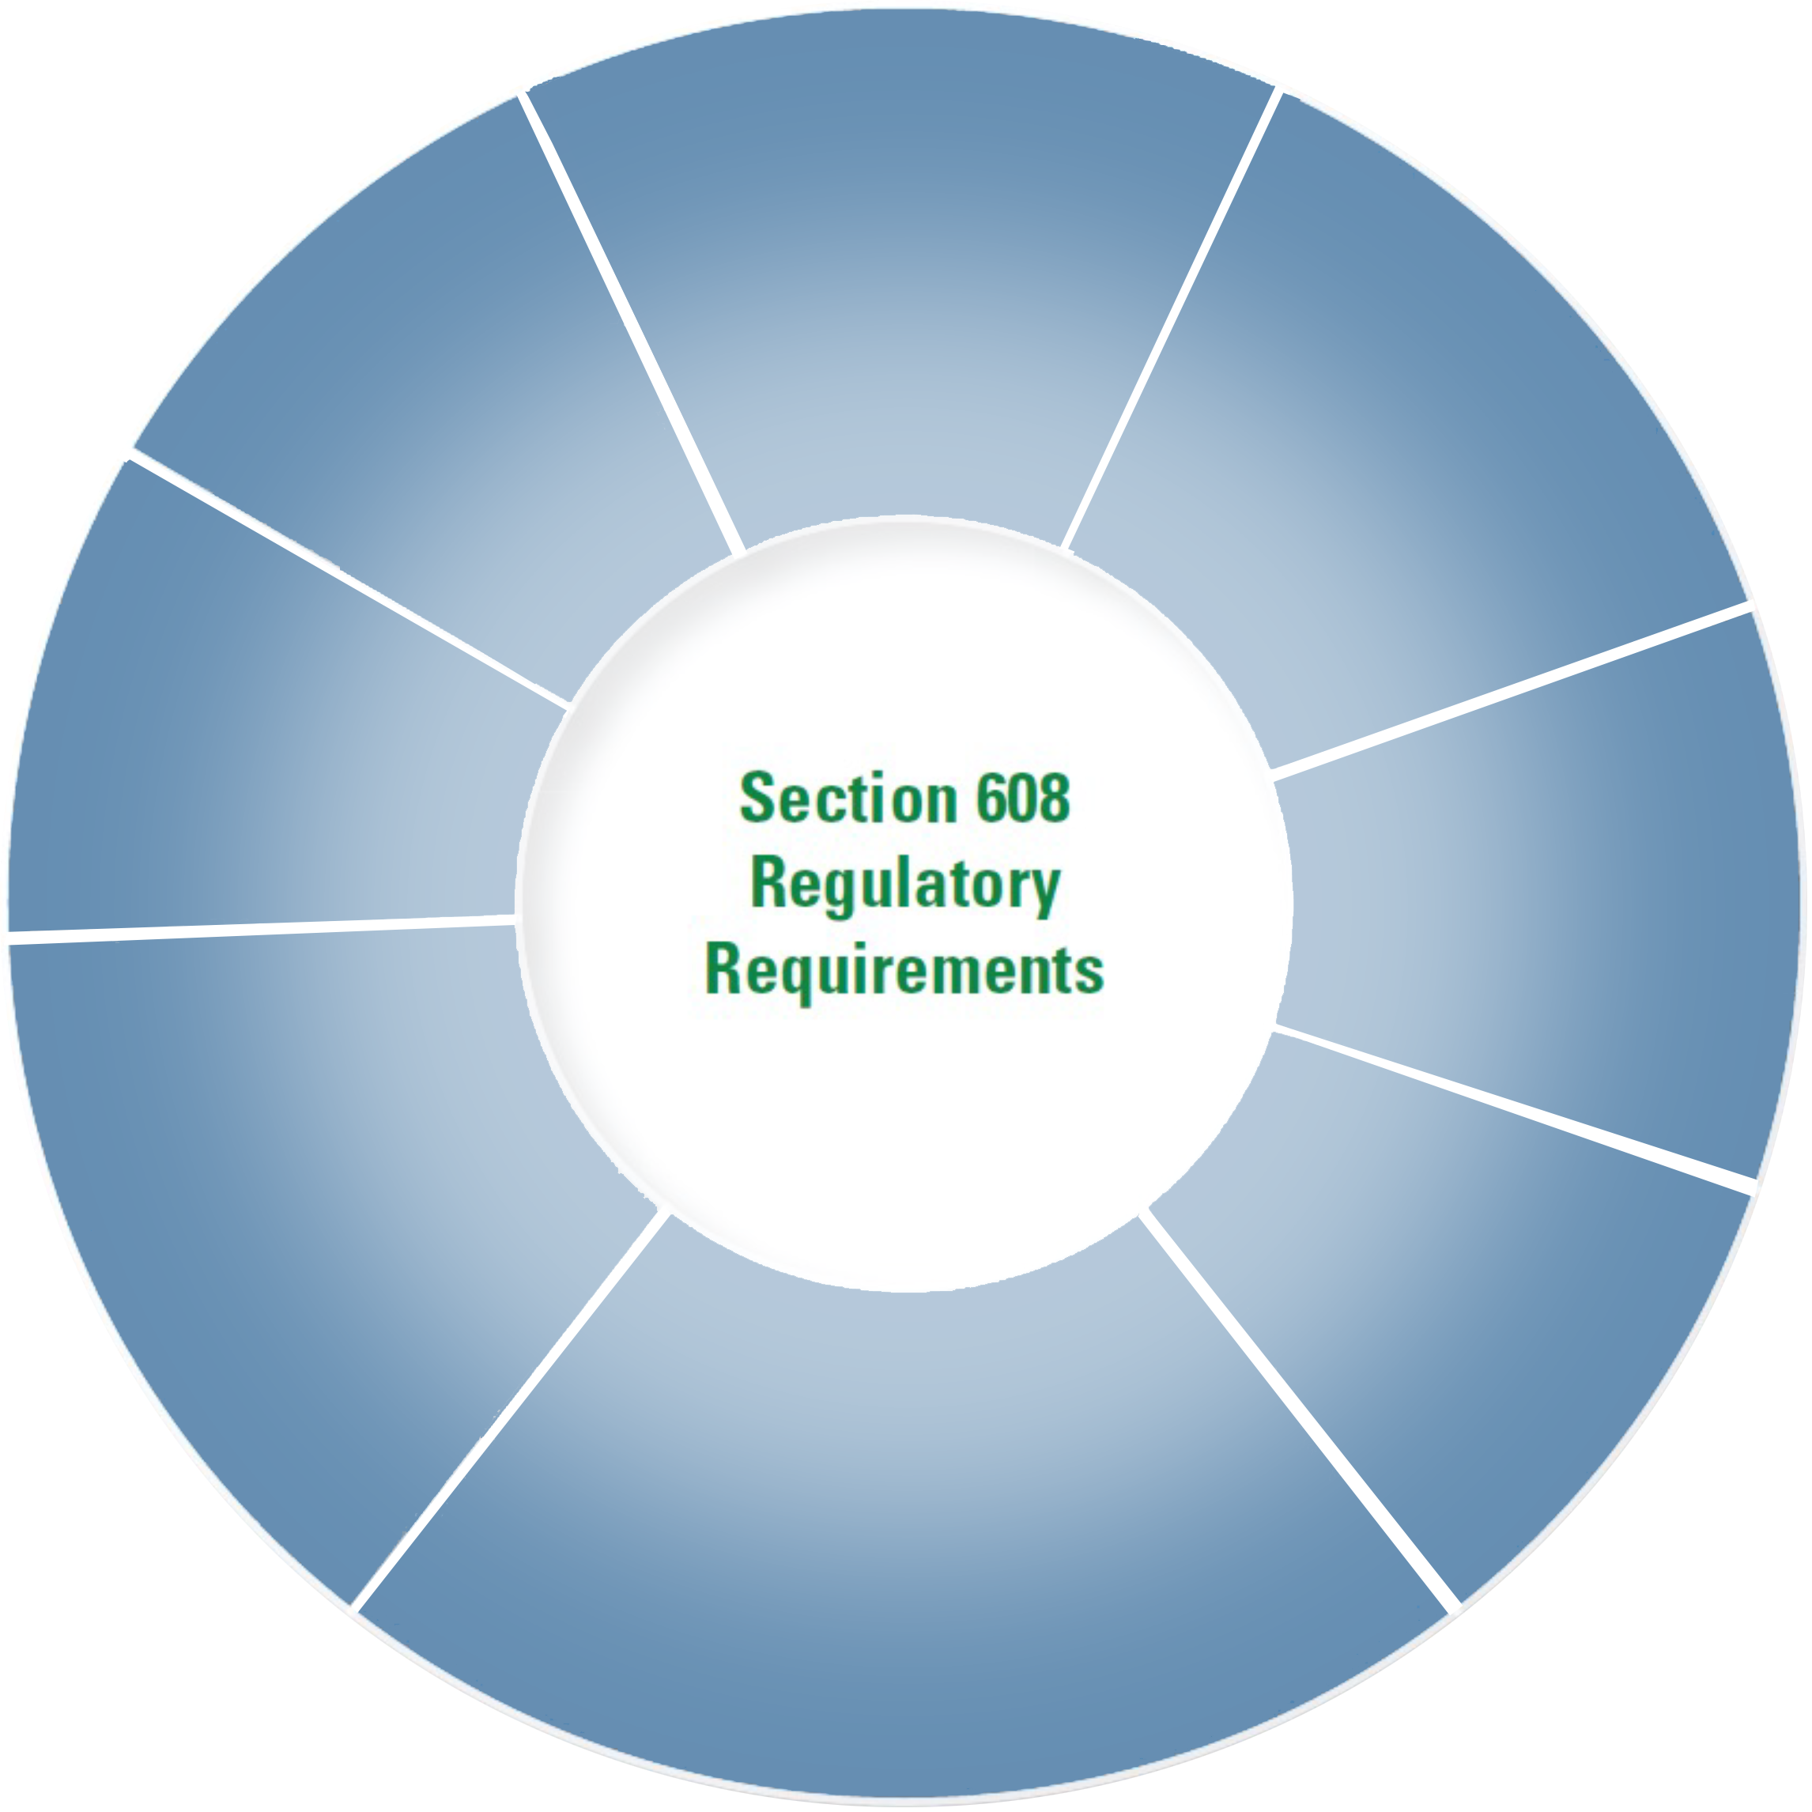
National Refrigerant Management Program
Technician Certification
Refrigerant Reclamation
Refrigerant Sales Restriction
Appliance Disposal
Service Practices
Repairing Refrigerant Leaks
Recovery & Recycling Equipment
Recordkeeping

Slide 3
National Refrigerant Management Program
What refrigerants are affected?
Ozone-depleting refrigerants (i.e., CFCs and HCFCs)
Currently subject to the Section 608(c) venting prohibition
Currently subject to the existing regulatory standards and requirements
Substitute refrigerants (e.g., HFCs, HFOs, and PFCs)
Includes any substitute refrigerant not specifically exempted*
Currently subject to the Section 608(c) venting prohibition
Will be subject to the regulatory standards and requirements starting 2017, 2018, or 2019
Exempt substitute refrigerants (e.g., ammonia and CO₂)
Not subject to the venting prohibition in specific end-uses
Not subject to the regulatory standards and requirements in those uses
May be subject to other requirements (e.g., OSHA)
*While these slides highlight appliances containing HFCs, appliances containing other non-exempt substitute refrigerants, including HFOs and HFO blends, are subject to the same requirements.

Slide 4
Changes to
Technician Certification
You must be a Section 608 certified technician to open HFC appliances (Starting 1/1/18) R-134a, 410a
EPA is not requiring recertification of current technicians at this time
EPA is not changing the types of certifications
EPA is developing an updated test bank for certifying new technicians
You must be a Section 608 certified technician to purchase HFC refrigerant (Starting 1/1/18)
Refrigerant distributors may only sell HFC refrigerants to certified technicians and must maintain records for those sales (Starting 1/1/18)
Throughout this presentation, the term HFC is being used to represent all non-exempt substitutes.

Slide 5
Changes to
Service Practices
Technicians must use certified recovery and/or recycling equipment when opening an HFC appliance (Starting 1/1/18)
Technicians must evacuate to the specified levels of vacuum when opening HFC appliances (Starting 1/1/18)
Newly manufactured or imported recovery and/or recycling equipment models must be certified for use with HFCs (Starting 1/1/17)
EPA is adopting a UL flammability standard as part of the certification to ensure the safe use of recovery equipment designed for flammable refrigerants (Starting 1/1/17)

Slide 6
Changes to Leak Repair
Leak Rates and Duty to Repair
Starting 1/1/2019, these modified leak repair requirements will apply to all refrigerants (excluding exempt refrigerants cited earlier)
The existing leak repair requirements will continue as is for ODS appliances until 1/1/19
The leak rate must be calculated every time refrigerant is added to an appliance containing ≥50 lbs. of refrigerant
The repair requirements described on the following slides apply starting January 1, 2019, only if over the threshold

Slide 7
Changes to Leak Repair
Leak Rates and Duty to Repair (Con’t)
Revised leak rate thresholds:
30% for Industrial Process Refrigeration (IPR) (lowered from 35%)
20% for commercial refrigeration (lowered from 35%)
10% for comfort cooling (lowered from 15%)
A certified technician must perform a leak inspection to identify the necessary repairs
The repair must bring the appliance leak rate below the threshold
Must be demonstrated when calculating leak rate upon next refrigerant addition

Slide 8
Changes to Leak Repair
Verification tests
Must demonstrate that leaks were successfully repaired
Initial verification tests- done before refrigerant is added back into the repaired appliance
Follow-up verification tests- done after the repaired appliance returns to normal operating characteristics and conditions
Requirement extended to commercial refrigeration and comfort cooling (currently required only for IPR)
If either the initial or follow-up verification test indicates that repairs were not successful, you may conduct as many additional repairs and verification tests as needed within the 30-day repair period

Slide 9
Changes to Leak Repair
Definition of Appliance:
Clarifies that each independent circuit in a system with multiple circuits is a separate appliance
Leak rate calculations:
Provides that under the “Rolling Average Method” (formerly “Method 2”) in order to “close out” a leak event the owner or operator must repair all identified leaks and verify that the repairs have been successful.
Recordkeeping:
Technicians must provide owners and operators with invoices (including amount of refrigerant added), and results of leak inspections and verification tests
Electronic recordkeeping encouraged

Slide 10
Changes to
Appliance Disposal
Appliances with 5 pounds of refrigerant or less
Existing safe disposal requirements extended to HFC appliances (Starting 1/1/18)
Appliances with between 5 and 50 pounds of refrigerant
New records for the disposal of appliances containing between 5 and 50 pounds of refrigerant (Starting 1/1/18)
Company name, location of the appliance, date of recovery, and type of refrigerant recovered for each appliance;
Amount of refrigerant (by type) recovered from all disposed appliances in each calendar month; and
Quantity of refrigerant (by type) transferred for reclamation and/or destruction, the person to whom it was transferred, and the date.
These records must be maintained by the technician and not the owner or operator of the appliance

Slide 11
Changes to Reclamation
EPA is establishing reclamation standards for HFCs and other refrigerants contained in AHRI Standard 700-2016 (Starting 1/1/17)
Reclaimers must analyze each batch of reclaimed refrigerant (Starting 1/1/17)
Annual reporting to EPA on amounts of refrigerant received and reclaimed includes HFCs (Starting 2018, for refrigerant received starting 1/1/17)

Slide 12
Outcomes of 608 Update
Consistent treatment of commonly used refrigerants (e.g., ODS, HFCs, blends)
Incorporating best management practices to reduce leaks from large appliances
Focus on ensuring repairs are effective
Enhancing clarity of the rules to improve compliance
Removing obsolete requirements

Slide 13
Outcomes of 608 Update
By promoting the proper handling of refrigerants, EPA anticipates:
The annual GHG emissions reduction is equivalent to the annual GHG emissions of 1.5 million cars
EPA estimates $44 million in savings from reduced purchases of refrigerant
Annual GHG Reduction (MMTCO₂eq) | Annual ODS Reduction (ODP-weighted MT) | Annual Incremental Compliance Cost (millions)
7.3 | 114 | $24.5
GHG: Greenhouse gas
MMTCO2eq: Million metric tons carbon dioxide equivalent
ODP: Ozone depletion potential
MT: Metric tons

Slide 14
Flammable Refrigerants
EPA has exempted certain hydrocarbon refrigerants from the venting prohibition when used in specific appliances and, as a consequence, the Section 608 requirements
These are new, self-contained, small appliances specifically designed to use hydrocarbon refrigerants
EPA does not anticipate that opening up such appliances for servicing or recharging will be common
Such appliances are identifiable by red tubing and other markings
It is illegal to use hydrocarbon or other flammable refrigerants (such as R-22a) in existing HCFC/HFC appliances
This is true whether the refrigerant is sold to a certified technician or not
Some flammable refrigerants are not exempt from the Section 608 requirements (such as HFC-32) and may only be purchased by a certified technician
Recovery and/or recycling equipment for use with such flammable refrigerants must be certified to ensure safety for those refrigerants

Slide 15
YOUR
IMPACT
Reporting on all appliances greater than 5 pounds
Technicians are now responsible and held accountable
Contractors (including scrapers) must collect data and must be able to report monthly
Scrapers must provide make, model, serial number or ID to the service technician for all removed equipment.
Wholesalers must provide docs for all recovery cylinders to contractors who must tie each pound back their recovery.
Reclaimers must provide documentation down the chain

Slide 16
OUR
IMPACT
Every Rapid Recovery Tech is EPA Certified.
All Rapid Recovery proprietary recovery equipment is already certified for HFCs as well as CFCs and HCFCs.
Rapid Recovery documentation exceeds all EPA requirements.
Rapid Recovery does not recover hydrocarbon or other flammable refrigerants (such as 22a). The use of these refrigerants in existing Type II HCFC/HFC appliances is illegal.
Rapid Recovery is the solution to this Contractor and Technician challenge. From recovery to documentation, we address it all.

Slide 17
STAY IN COMPLIANCE WITH
RAPID RECOVERY
877.372.7732 | www.raprec.com

